Slide 1

African Traditional Architecture
CLARRISON KITPTIKEN
C025-01-2425/2019

Slide 2
Introduction
African traditional architecture is a diverse and rich expression of cultural heritage, embodying ingenuity, sustainability, and deep-rooted traditions.
It encompasses a wide range of styles, materials, and construction techniques, reflecting the continent's diverse ecological landscapes and cultural influences.
African traditional architecture has played a vital role in shaping the identity and cultural expression of African communities for centuries.
It represent a rich cultural heritage that has evolved over centuries, reflecting the diverse landscapes, climates, and societies across the continent. These architectural styles are not only aesthetically captivating but also possess intrinsic connections to the geographical and environmental contexts in which they are situated. In this essay presentation, we will explore the significance of African Traditional Architecture and Design in the field Information Technology

Slide 3
IT and African Traditional Architecture
Information technology (IT) plays a crucial role in understanding, preserving, and promoting African traditional architecture. Through various digital tools and systems, IT provides essential resources for documenting, analyzing, and modeling these unique architectural structures.
Digital Imaging and Modeling: Advanced digital imaging techniques, such as satellite imagery and Light Detection and Ranging (LiDAR), facilitate the creation of detailed maps and 3D models of architectural sites. These technologies are invaluable for capturing detailed visual data of structures, even in remote or hard-to-reach areas. The resulting high-resolution images and data sets allow for in-depth analysis and visualization, making it easier to understand architectural details and spatial configurations.
High-Precision Measurement Technologies: Technologies like terrestrial laser scanning and photogrammetry are used to achieve precise measurements of architectural elements. These IT tools enable the accurate digital replication of buildings, creating virtual blueprints that are crucial for both preservation and restoration projects. The precision offered by these methods ensures that every detail is captured, preserving the integrity and authenticity of traditional architecture.

Slide 4


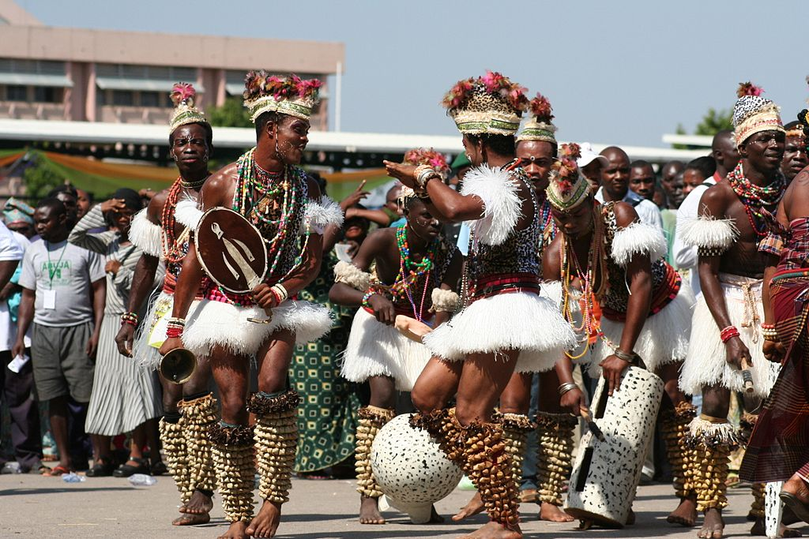

Slide 5
Significance of African Traditional Architecture to IT
Cultural Documentation and Preservation: African traditional architecture embodies rich cultural narratives and practices. IT plays a critical role in preserving these narratives through digital documentation. High-resolution imaging, 3D modeling, and digital archiving allow for the meticulous capture of architectural details, ensuring that these cultural assets are preserved for future generations. .
Educational and Research Opportunities: The digitization of African traditional architecture provides an invaluable resource for education and research. IT enables the creation of virtual models and databases, which can be accessed globally by researchers, historians, and students
Innovation in Design and Restoration: African traditional architecture often features unique structural and aesthetic elements. IT tools like CAD (Computer-Aided Design) and BIM (Building Information Modeling) can leverage these traditional designs to inspire contemporary architectural projects.
Enhanced Accessibility and Tourism: Through virtual tours and augmented reality (AR) applications, IT can make African traditional architecture accessible to a broader audience. Virtual platforms allow people worldwide to explore these architectural wonders, promoting cultural tourism and awareness.

Slide 6
Preservation and Sustainable Development
African traditional architecture offers valuable lessons for sustainable design and construction practices.
The use of locally sourced natural materials, passive cooling techniques, and harmonious integration with the natural environment embody principles of sustainability that are increasingly relevant in today's world.
IT play a crucial role in documenting, analyzing, and disseminating these sustainable practices.
By creating digital repositories of traditional architectural knowledge and practices, geomatics professionals can contribute to the preservation and revival of sustainable building techniques.

Slide 7
Adaptability and Resilience
Adaptability
African traditional architecture exemplifies adaptability through its use of locally available materials, environmental considerations, and responsiveness to cultural practices. These structures often reflect a deep understanding of the local climate, resources, and socio-cultural needs, resulting in designs that are both functional and harmonious with their surroundings.
In the realm of IT, adaptability manifests in the flexible use of technology to document, analyze, and preserve these architectural forms. IT tools can adapt to different types of data, from high-resolution images and 3D scans to textual descriptions and oral histories. This flexibility allows for comprehensive documentation and preservation strategies that can be tailored to specific cultural contexts and technological requirements.
Resilience
The resilience of African traditional architecture is evident in its long-standing structures that have withstood environmental challenges such as harsh weather conditions and natural disasters. This resilience is often achieved through ingenious design features, such as elevated floors, natural ventilation systems, and the use of durable materials.
IT contributes to the resilience of these architectural treasures by enabling their digital preservation. Digital records ensure that even if physical structures are damaged or destroyed, detailed information about their design and cultural significance remains accessible.

Slide 8
Cultural Expression and Identity
Cultural Expression
African traditional architecture serves as a canvas for cultural expression, showcasing unique artistic styles, symbolic decorations, and construction techniques. Each structure often embodies the cultural values, religious beliefs, and social norms of its community. For instance, the intricate carvings and motifs found in buildings can represent spiritual beliefs, historical events, or social status. The choice of materials, construction methods, and spatial organization also reflect the relationship between people and their environment, as well as their adaptation to local conditions.
IT enhances the ability to capture and share these cultural expressions by providing tools for detailed documentation and analysis. High-resolution photography, 3D scanning, and virtual reality (VR) technologies allow for the creation of immersive digital representations of these architectural wonders. These digital tools help preserve intricate details that might otherwise be lost and enable a broader audience to experience and appreciate the cultural richness embodied in traditional structures.
Identity
Traditional architecture is a vital element of cultural identity, serving as a tangible connection to a community's past and present. It encapsulates the heritage, stories, and identities of the people who built and used these structures. The distinct architectural styles across different regions of Africa highlight the continent's rich cultural diversity and the unique identity of each community.

Slide 9
Global Recognition and Cultural Exchange
Global Recognition
The unique and diverse architectural styles found across Africa represent a significant cultural achievement. However, due to historical and geographical factors, these contributions have often been underrepresented on the global stage. IT facilitates greater visibility and appreciation of African traditional architecture by making it accessible to a global audience. Through digital platforms, virtual tours, and online archives, people from around the world can explore these architectural marvels, gaining insights into the cultural and historical contexts that shaped them.
High-resolution images, 3D models, and immersive VR experiences allow for detailed and engaging presentations of traditional structures, highlighting their beauty, craftsmanship, and cultural significance. Additionally, scholarly research facilitated by IT tools, such as digital databases and GIS, contributes to a deeper understanding and recognition of the architectural heritage of Africa in academic and professional circles.

Slide 10
Inspiration for Modern Architecture
African traditional architecture offers a wealth of inspiration for modern architectural design, blending functionality, sustainability, and aesthetic beauty. Through the use of information technology (IT), these traditional forms and principles can be studied, preserved, and adapted in contemporary architectural practices. Here are key ways in which African traditional architecture inspires modern architecture:
Sustainable Building Practices
One of the most significant contributions of African traditional architecture is its emphasis on sustainability. Many traditional structures were designed with local materials and techniques that minimize environmental impact. For instance, the use of natural cooling systems, such as courtyards, ventilation openings, and thick walls made of earth or stone, exemplifies climate-responsive design.
Modern architecture can draw inspiration from these sustainable practices by integrating passive cooling techniques and local materials into new constructions. IT facilitates the study and application of these traditional methods through detailed digital documentation and analysis, allowing architects to adapt them to contemporary building codes and environmental standards.

Slide 11
Conclusion
The convergence of African traditional architecture and information technology (IT) offers a unique opportunity to bridge the past and future, honoring cultural heritage while embracing modern innovations. African traditional architecture, with its rich diversity, deep cultural significance, and sustainable practices, serves as a valuable source of inspiration and knowledge for contemporary design and construction.
IT plays a pivotal role in preserving, studying, and promoting this architectural heritage. Through digital documentation, virtual modeling, and data analysis, IT enables the detailed recording and analysis of traditional structures. This digital preservation is crucial for safeguarding these cultural treasures against threats such as environmental degradation, urbanization, and the passage of time.

